Slide 1
Chapter 15
Repeated-Measures ANOVA

Slide 2
Aims
Rationale of repeated-measures designs
  One- and two-way designs
  Benefits
Partitioning variance
Statistical problems with repeated measures designs
  Sphericity
  Overcoming these problems
Interpretation

Slide 3
Repeated-Measures Designs
Reminder: The same group of participants completes all levels of the treatment
Put another way, all participants are in all groups

Slide 4
Benefits of Repeated-Measures Designs
Sensitivity
  Unsystematic variance is reduced.
  More sensitive to experimental effects.
Economy
  Less participants are needed.
  But, be careful of fatigue!
Notes:
Less people == less individual differences to worry about

Slide 5
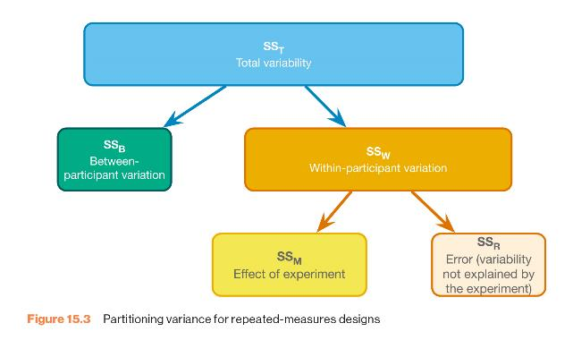
The Variance Approach (ANOVA) to Repeated-Measures Designs

Slide 6
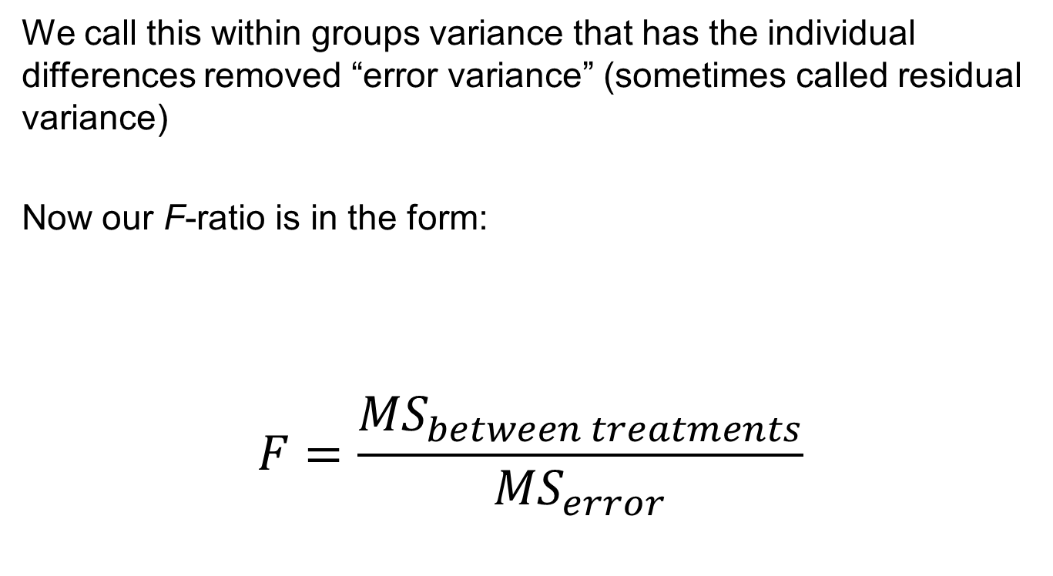
New design, new F Stat
We call this within groups variance that has the individual differences removed “error variance” (sometimes called residual variance)
Now our F-ratio is in the form:
$$F=\frac{{MS}_{between treatments}}{{MS}_{error}}$$

Slide 7
Sniffer Dog Example (1)
Dog | Alien | Human | Mannequin | Shapeshifter
Milton | 8 | 7 | 1 | 6
Woofy | 9 | 5 | 2 | 5
Ramsey | 6 | 2 | 3 | 8
Mr. Snifficus III | 5 | 3 | 1 | 9
Willock | 8 | 4 | 5 | 8
The Venerable Dr. Waggy | 7 | 5 | 6 | 7
Lord Scenticle | 10 | 2 | 7 | 2
Professor Nose | 12 | 6 | 8 | 1
Notes:
an alien invasion using sniffer dogs trained to detect different scents, including those of humans and potential shapeshifting aliens. Dogs were trained to make vocalizations when sniffing aliens
Is there an effect of entity? Do the dogs bark more for aliens compared to humans and mannequins. Additionally, can they detect the shapeshifted aliens?

Slide 8
Sniffer Dog Example (2)
Dog | Alien | Human | Mannequin | Shapeshifter
Milton | 8 | 7 | 1 | 6
Woofy | 9 | 5 | 2 | 5
Ramsey | 6 | 2 | 3 | 8
Mr. Snifficus III | 5 | 3 | 1 | 9
Willock | 8 | 4 | 5 | 8
The Venerable Dr. Waggy | 7 | 5 | 6 | 7
Lord Scenticle | 10 | 2 | 7 | 2
Professor Nose | 12 | 6 | 8 | 1
Mean | 8.13 | 4.25 | 4.13 | 5.75

Slide 9
Sniffer Dog Example (3)
Dog | Alien | Human | Mannequin | Shapeshifter | Mean
Milton | 8 | 7 | 1 | 6 | 5.50
Woofy | 9 | 5 | 2 | 5 | 5.25
Ramsey | 6 | 2 | 3 | 8 | 4.75
Mr. Snifficus III | 5 | 3 | 1 | 9 | 4.50
Willock | 8 | 4 | 5 | 8 | 6.25
The Venerable Dr. Waggy | 7 | 5 | 6 | 7 | 6.25
Lord Scenticle | 10 | 2 | 7 | 2 | 5.25
Professor Nose | 12 | 6 | 8 | 1 | 6.75
Mean | 8.13 | 4.25 | 4.13 | 5.75 | 5.62
Notes:
Red = grand mean (MG)

Slide 10
Sniffer Dog Example (4)
Dog | Alien | Human | Mannequin | Shapeshifter | Mean (M_{P})
Milton | 8 | 7 | 1 | 6 | 5.50
Woofy | 9 | 5 | 2 | 5 | 5.25
Ramsey | 6 | 2 | 3 | 8 | 4.75
Mr. Snifficus III | 5 | 3 | 1 | 9 | 4.50
Willock | 8 | 4 | 5 | 8 | 6.25
The Venerable Dr. Waggy | 7 | 5 | 6 | 7 | 6.25
Lord Scenticle | 10 | 2 | 7 | 2 | 5.25
Professor Nose | 12 | 6 | 8 | 1 | 6.75
Mean | 8.13 | 4.25 | 4.13 | 5.75 | 5.62
Now that we have the means, its time to calculate SS!
Need SS_{T}, SS_{B}, and SS_{R}
Notes:
Red = grand mean (MG)

Slide 11
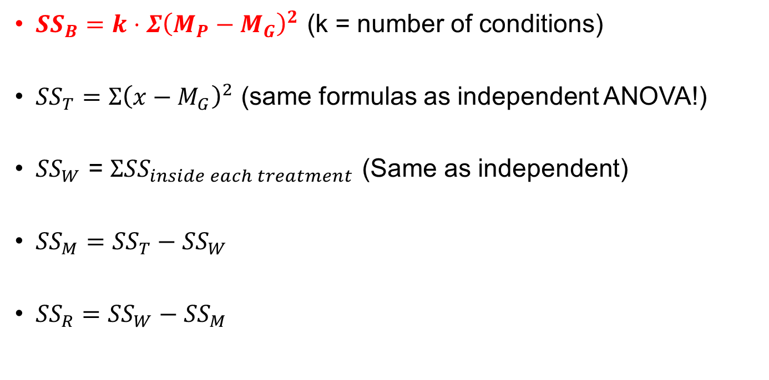
SS Formulas (Repeated Measures)
${SS}_{B}=k⋅Σ{\left(M_{P}−M_{G}\right)}^{2}$ (k = number of conditions)
${SS}_{T}=Σ{\left(x−M_{G}\right)}^{2}$ (same formulas as independent ANOVA!)
${SS}_{W}$ = $Σ{SS}_{inside each treatment}$ (Same as independent)
${SS}_{M}={SS}_{T}−{SS}_{W}$
${SS}_{R}={SS}_{W}−{SS}_{M}$

Slide 12
Calculate SS_{B} (1)
Dog | Mean (M_{P}) | M_{G} | (M_{P} – M_{G})²
Milton | 5.50 | 5.62
Woofy | 5.25 | 5.62
Ramsey | 4.75 | 5.62
Mr. Snifficus III | 4.50 | 5.62
Willock | 6.25 | 5.62
The Venerable Dr. Waggy | 6.25 | 5.62
Lord Scenticle | 5.25 | 5.62
Professor Nose | 6.75 | 5.62
Notes:
Red = grand mean (MG)

Slide 13
Calculate SS_{B} (2)
Dog | Mean (M_{P}) | M_{G} | (M_{P} – M_{G})²
Milton | 5.50 | 5.62 | .014
Woofy | 5.25 | 5.62 | .14
Ramsey | 4.75 | 5.62 | .76
Mr. Snifficus III | 4.50 | 5.62 | 1.25
Willock | 6.25 | 5.62 | 0.40
The Venerable Dr. Waggy | 6.25 | 5.62 | 0.40
Lord Scenticle | 5.25 | 5.62 | 0.14
Professor Nose | 6.75 | 5.62 | 1.28
 |  | Total | 4.38
Notes:
Red = grand mean (MG)

Slide 14
Calculate SS_{B} (3)
Dog | Mean (M_{P}) | M_{G} | (M_{P} – M_{G})²
Milton | 5.50 | 5.62 | .014
Woofy | 5.25 | 5.62 | .14
Ramsey | 4.75 | 5.62 | .76
Mr. Snifficus III | 4.50 | 5.62 | 1.25
Willock | 6.25 | 5.62 | 0.40
The Venerable Dr. Waggy | 6.25 | 5.62 | 0.40
Lord Scenticle | 5.25 | 5.62 | 0.14
Professor Nose | 6.75 | 5.62 | 1.28
 |  | Total | 4.38
 |  | SS_{M} (total * k)
Notes:
Red = grand mean (MG)

Slide 15
Calculate SS_{B} (4)
Dog | Mean (M_{P}) | M_{G} | (M_{P} – M_{G})²
Milton | 5.50 | 5.62 | .014
Woofy | 5.25 | 5.62 | .14
Ramsey | 4.75 | 5.62 | .76
Mr. Snifficus III | 4.50 | 5.62 | 1.25
Willock | 6.25 | 5.62 | 0.40
The Venerable Dr. Waggy | 6.25 | 5.62 | 0.40
Lord Scenticle | 5.25 | 5.62 | 0.14
Professor Nose | 6.75 | 5.62 | 1.28
 |  | Total | 4.38
 |  | SS_{B} (total * k) | 17.54
Notes:
Red = grand mean (MG)

Slide 16
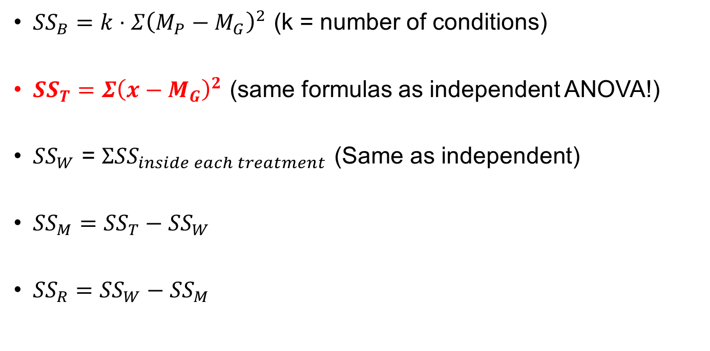
SS Formulas (Repeated Measures)
${SS}_{B}=k⋅Σ{\left(M_{P}−M_{G}\right)}^{2}$ (k = number of conditions)
${SS}_{T}=Σ{\left(x−M_{G}\right)}^{2}$ (same formulas as independent ANOVA!)
${SS}_{W}$ = $Σ{SS}_{inside each treatment}$ (Same as independent)
${SS}_{M}={SS}_{T}−{SS}_{W}$
${SS}_{R}={SS}_{W}−{SS}_{M}$

Slide 17
Calculate SS_{T}
Dog | Alien | Human | Mannequin | Shapeshifter | Mean
Milton | 8 | 7 | 1 | 6 | 5.50
Woofy | 9 | 5 | 2 | 5 | 5.25
Ramsey | 6 | 2 | 3 | 8 | 4.75
Mr. Snifficus III | 5 | 3 | 1 | 9 | 4.50
Willock | 8 | 4 | 5 | 8 | 6.25
The Venerable Dr. Waggy | 7 | 5 | 6 | 7 | 6.25
Lord Scenticle | 10 | 2 | 7 | 2 | 5.25
Professor Nose | 12 | 6 | 8 | 1 | 6.75
Mean | 8.13 | 4.25 | 4.13 | 5.75 | 5.62
Each individual X – M_{G}, squared, then summed
SS_{T} = 253.875
Notes:
Red = grand mean (MG)

Slide 18
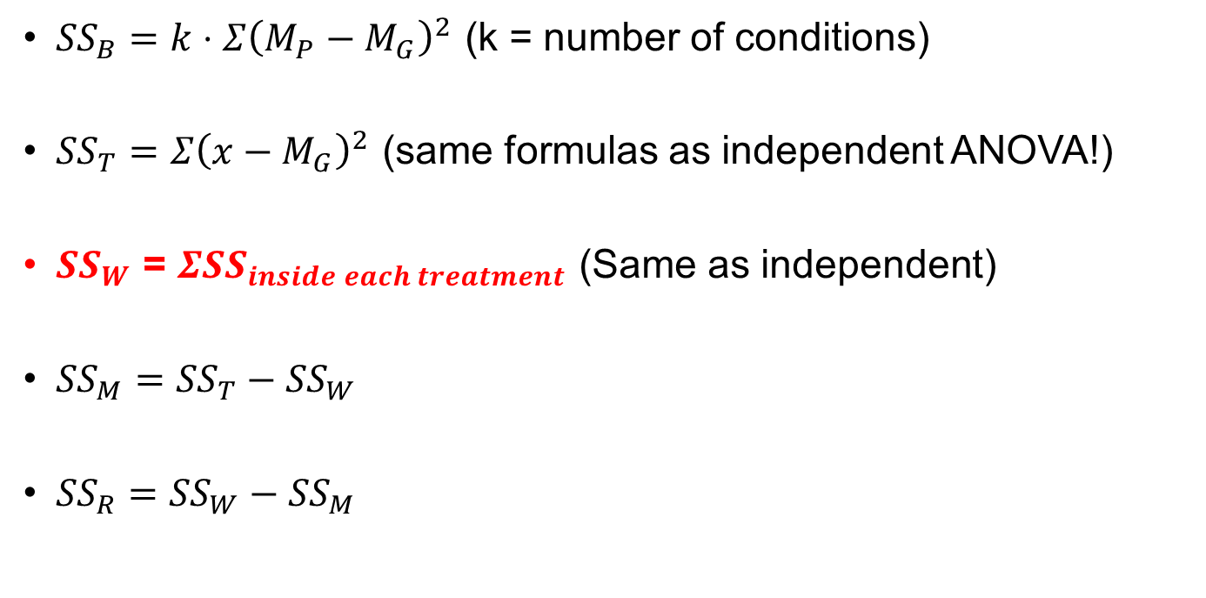
SS Formulas (Repeated Measures)
${SS}_{B}=k⋅Σ{\left(M_{P}−M_{G}\right)}^{2}$ (k = number of conditions)
${SS}_{T}=Σ{\left(x−M_{G}\right)}^{2}$ (same formulas as independent ANOVA!)
${SS}_{W}$ = $Σ{SS}_{inside each treatment}$ (Same as independent)
${SS}_{M}={SS}_{T}−{SS}_{W}$
${SS}_{R}={SS}_{W}−{SS}_{M}$

Slide 19
Calculate SS_{W} (1)
Dog | Alien | Human | Mannequin | Shapeshifter | Mean
Milton | 8 | 7 | 1 | 6 | 5.50
Woofy | 9 | 5 | 2 | 5 | 5.25
Ramsey | 6 | 2 | 3 | 8 | 4.75
Mr. Snifficus III | 5 | 3 | 1 | 9 | 4.50
Willock | 8 | 4 | 5 | 8 | 6.25
The Venerable Dr. Waggy | 7 | 5 | 6 | 7 | 6.25
Lord Scenticle | 10 | 2 | 7 | 2 | 5.25
Professor Nose | 12 | 6 | 8 | 1 | 6.75
Mean (M_{C}) | 8.13 | 4.25 | 4.13 | 5.75 | 5.62
Each individual condition X – M_{C}, squared, then summed. This will give you four values (SS values for each column). Then add the four!
SS_{W} =
Notes:
Red = grand mean (MG)

Slide 20
Calculate SS_{W} (2)
Dog | Alien | Human | Mannequin | Shapeshifter | Mean
Milton | 8 | 7 | 1 | 6 | 5.50
Woofy | 9 | 5 | 2 | 5 | 5.25
Ramsey | 6 | 2 | 3 | 8 | 4.75
Mr. Snifficus III | 5 | 3 | 1 | 9 | 4.50
Willock | 8 | 4 | 5 | 8 | 6.25
The Venerable Dr. Waggy | 7 | 5 | 6 | 7 | 6.25
Lord Scenticle | 10 | 2 | 7 | 2 | 5.25
Professor Nose | 12 | 6 | 8 | 1 | 6.75
Mean (M_{C}) | 8.13 | 4.25 | 4.13 | 5.75 | 5.62
SS_{Inside} | 34.875 | 23.5 | 52.875 | 59.5
SS_{W} = sum(SS_{Inside}) = 170.75
Notes:
Red = grand mean (MG)

Slide 21
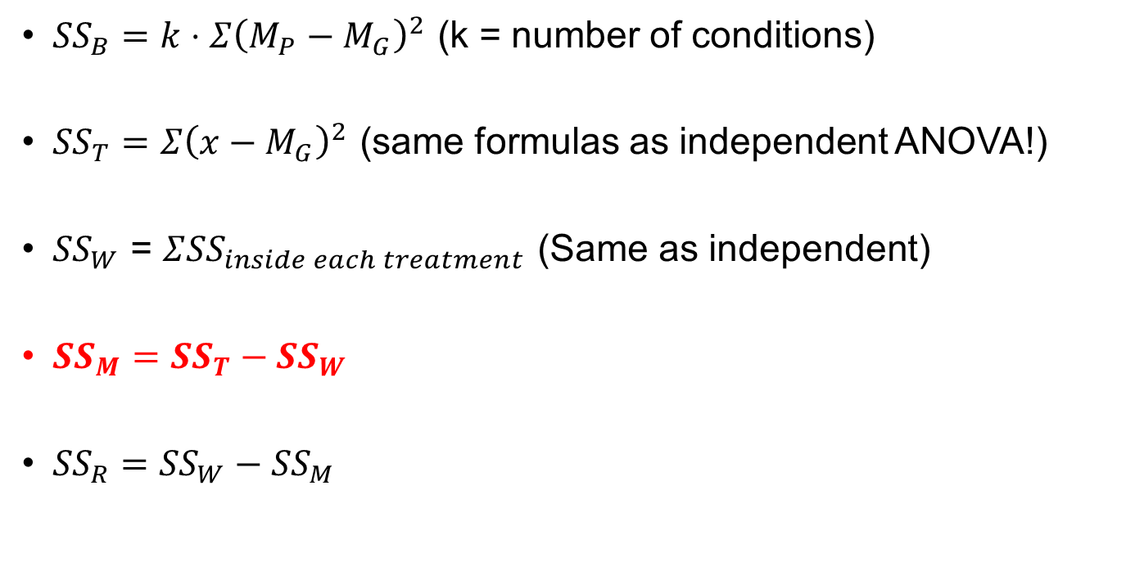
SS Formulas (Repeated Measures)
${SS}_{B}=k⋅Σ{\left(M_{P}−M_{G}\right)}^{2}$ (k = number of conditions)
${SS}_{T}=Σ{\left(x−M_{G}\right)}^{2}$ (same formulas as independent ANOVA!)
${SS}_{W}$ = $Σ{SS}_{inside each treatment}$ (Same as independent)
${SS}_{M}={SS}_{T}−{SS}_{W}$
${SS}_{R}={SS}_{W}−{SS}_{M}$

Slide 22
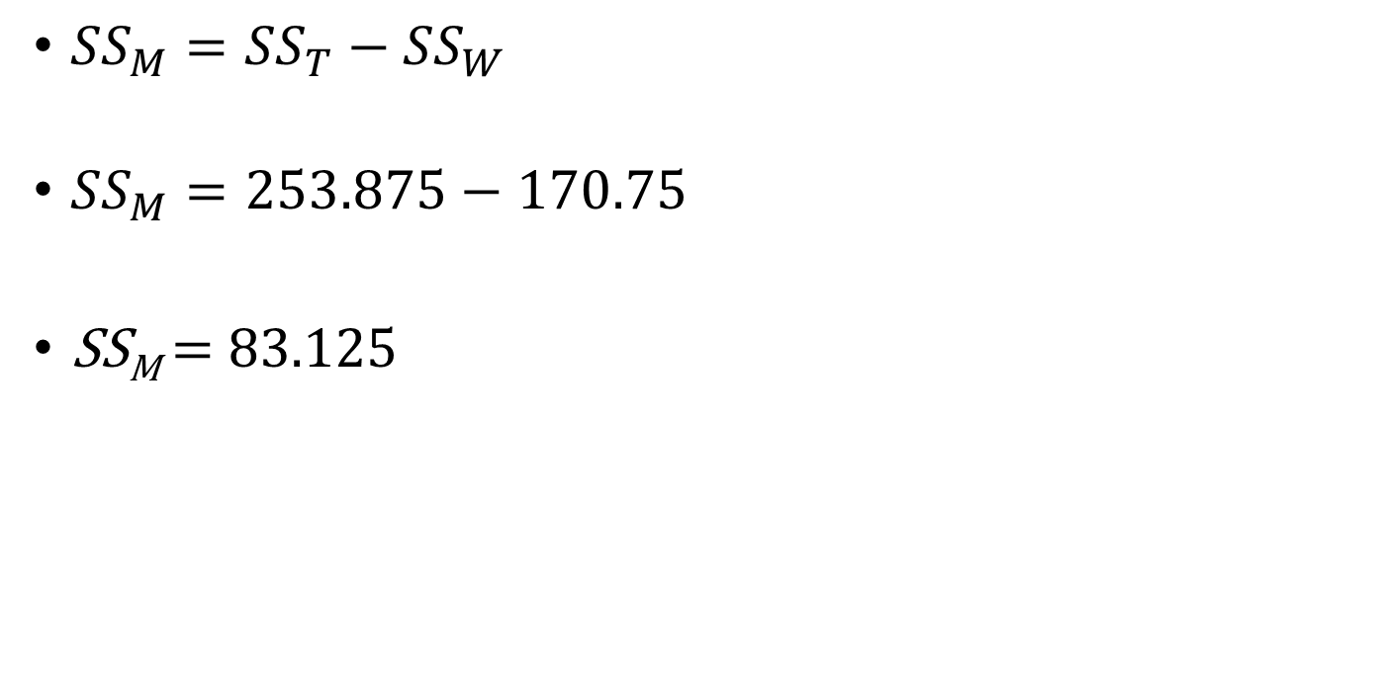
Calculate SS_{M}
${SS}_{M}={SS}_{T}−{SS}_{W}$
${SS}_{M}=253.875−170.75$
SS_{M} = 83.125

Slide 23
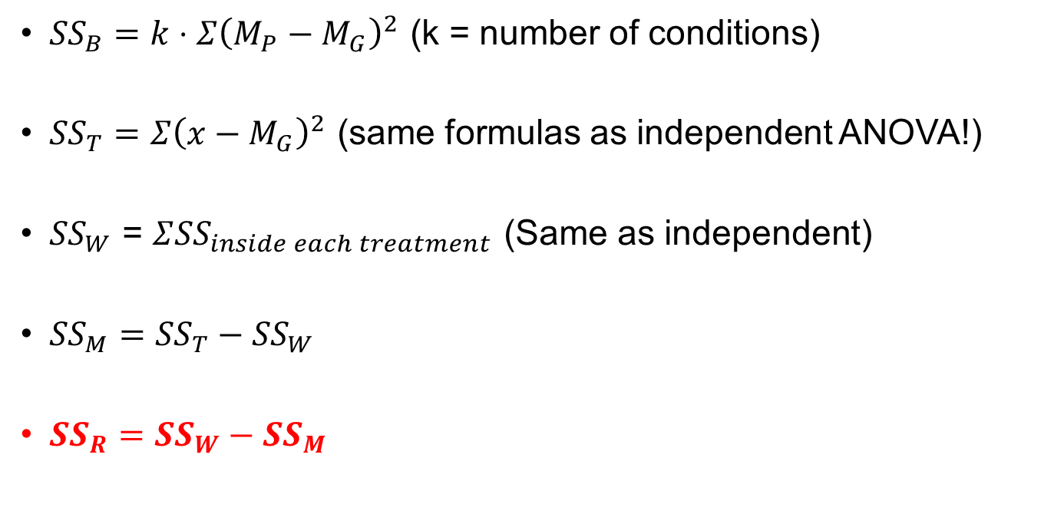
SS Formulas (Repeated Measures)
${SS}_{B}=k⋅Σ{\left(M_{P}−M_{G}\right)}^{2}$ (k = number of conditions)
${SS}_{T}=Σ{\left(x−M_{G}\right)}^{2}$ (same formulas as independent ANOVA!)
${SS}_{W}$ = $Σ{SS}_{inside each treatment}$ (Same as independent)
${SS}_{M}={SS}_{T}−{SS}_{W}$
${SS}_{R}={SS}_{W}−{SS}_{M}$

Slide 24
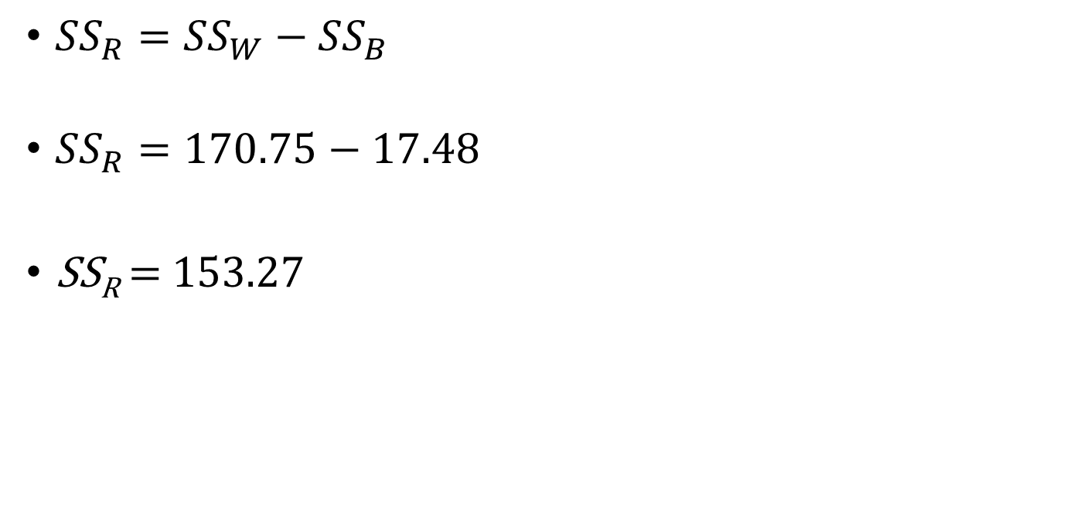
Calculate SS_{R}
${SS}_{R}={SS}_{W}−{SS}_{B}$
${SS}_{R}=170.75−17.48$
SS_{R} = 1$53.27$

Slide 25
Next Steps
Compute dfs
Compute MS values
Calculate F

Slide 26
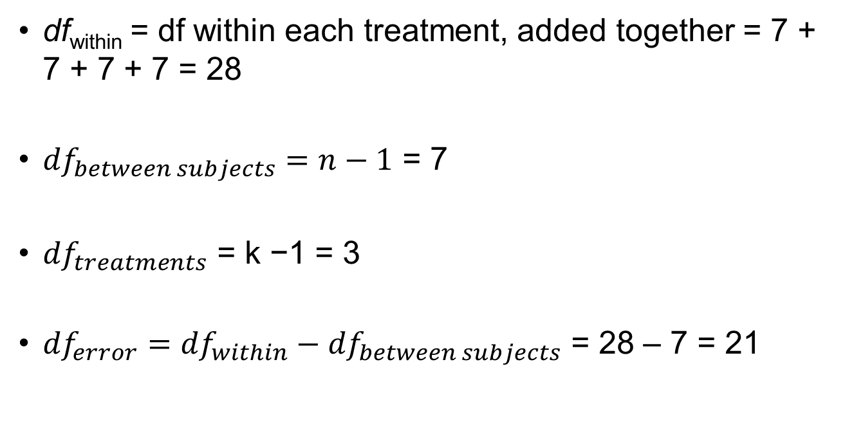
Degrees of Freedom
df_{within} = df within each treatment, added together = 7 + 7 + 7 + 7 = 28
${df}_{between subjects}=n−1$ = 7
${df}_{treatments}$ = k −1 = 3
${df}_{error}={df}_{within}−{df}_{between subjects}$ = 28 – 7 = 21

Slide 27
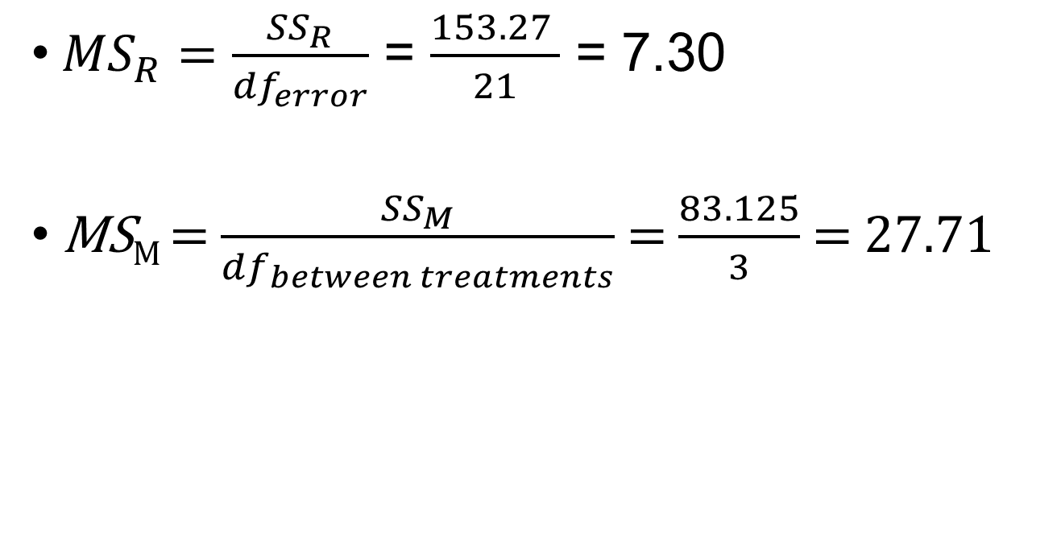
Calculate MS
${MS}_{R}=\frac{{SS}_{R}}{{df}_{error}}$ = $\frac{153.27 }{21}$ = 7.30
MS_{M} = $\frac{{SS}_{M}}{{df}_{between treatments}}$ = $\frac{83.125}{3}$ = 27.71

Slide 28
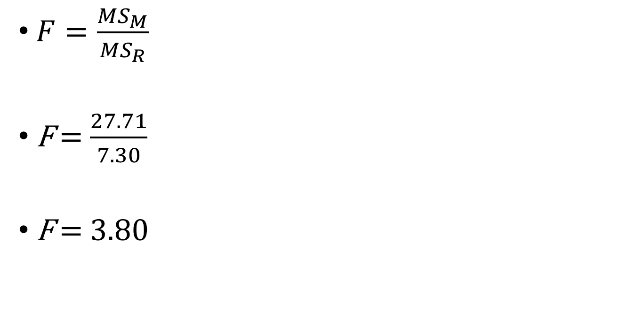
Calculate F
$F=\frac{{MS}_{M}}{{MS}_{R}}$
F = $\frac{27.71}{7.30}$
F = 3.80

Slide 29
Is it Significant?
Check the F table!
Find the critical F for the degrees of freedom (3, 21)
If calculated F is greater than test-statistic, then its significant

Slide 30
The Assumption of Sphericity
Basically means that the correlation between treatment levels is the same.
More specifically, it assumes that the variances of differences between conditions is equal.
Estimated and adjusted for using:
  Greenhouse-Geisser estimate.
  Huynh-Feldt estimate.
Tested using Mauchly’s test (SPSS will do this for you)
  P < .05, sphericity is violated (use a correction)
  P > .05, sphericity is met (no correction needed)
Notes:
variances.

